Slide 1
Leduc Center Survey
Student Survey to understand impact of civic engagement

Slide 2
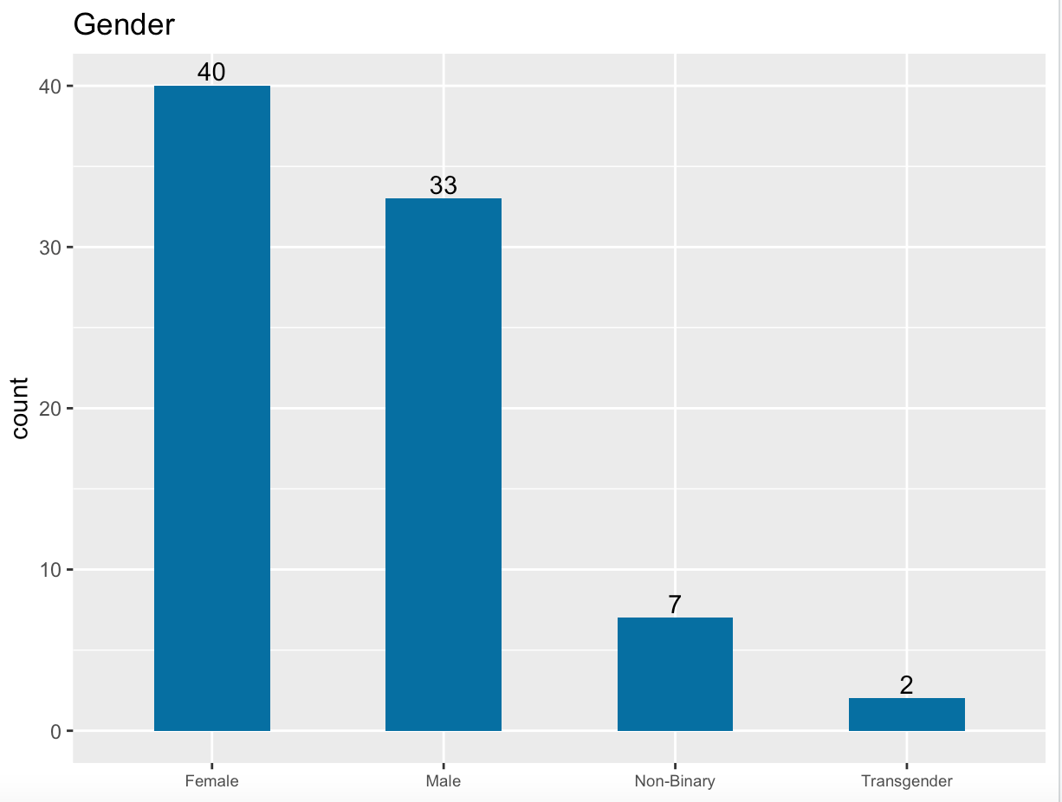
Responders overview
We had 82 responses in total.
49% identified as female and 40% identified as male.
We had 2 responses from people who identified as transgender.

Slide 3
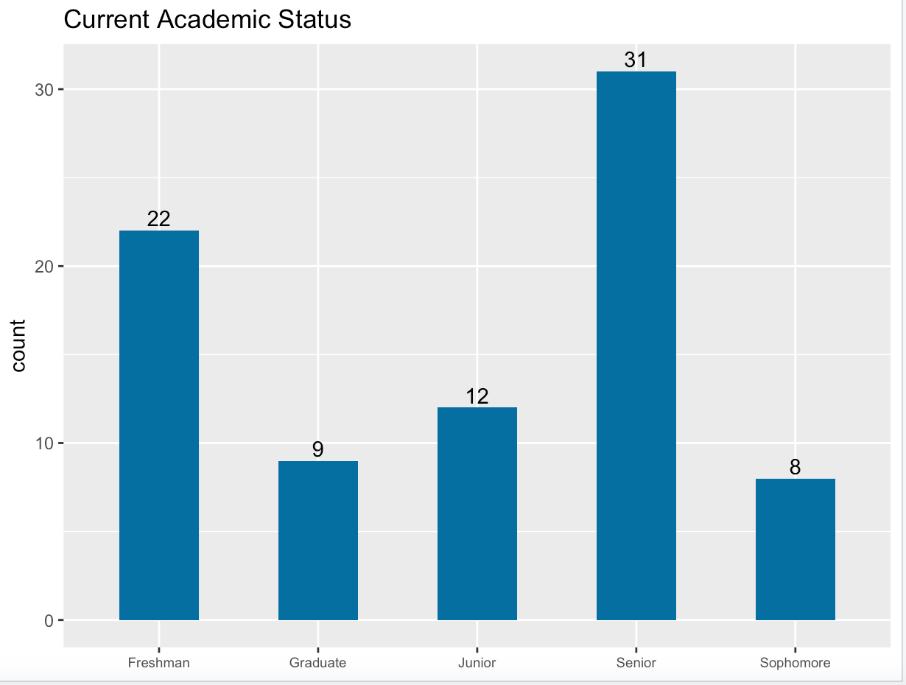
Responders overview
38% of the participants were seniors .
After that, 22 were freshman and 12 were juniors.

Slide 4
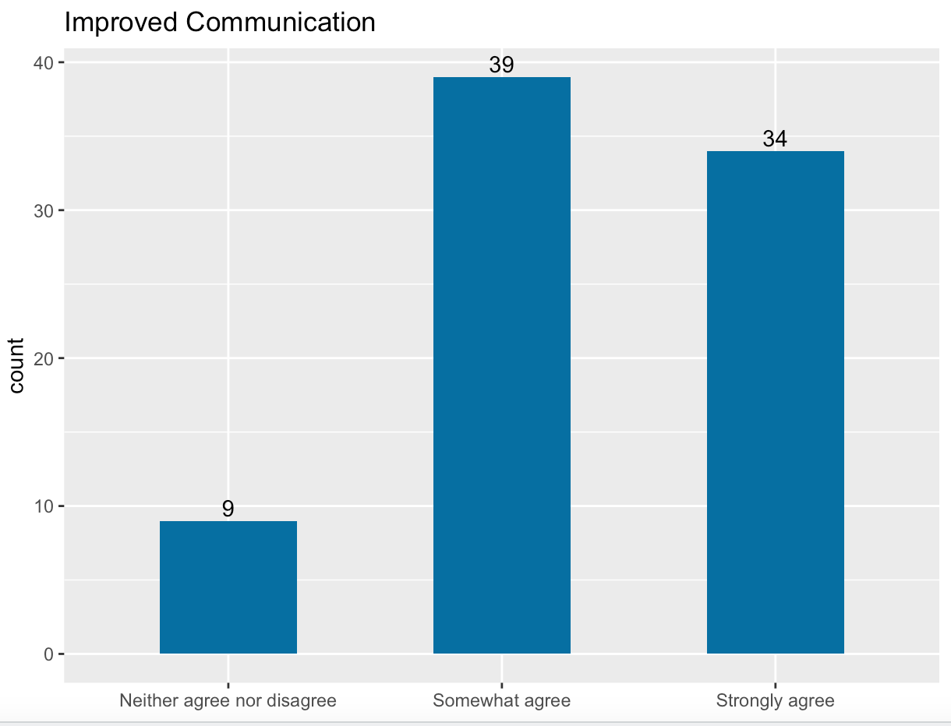
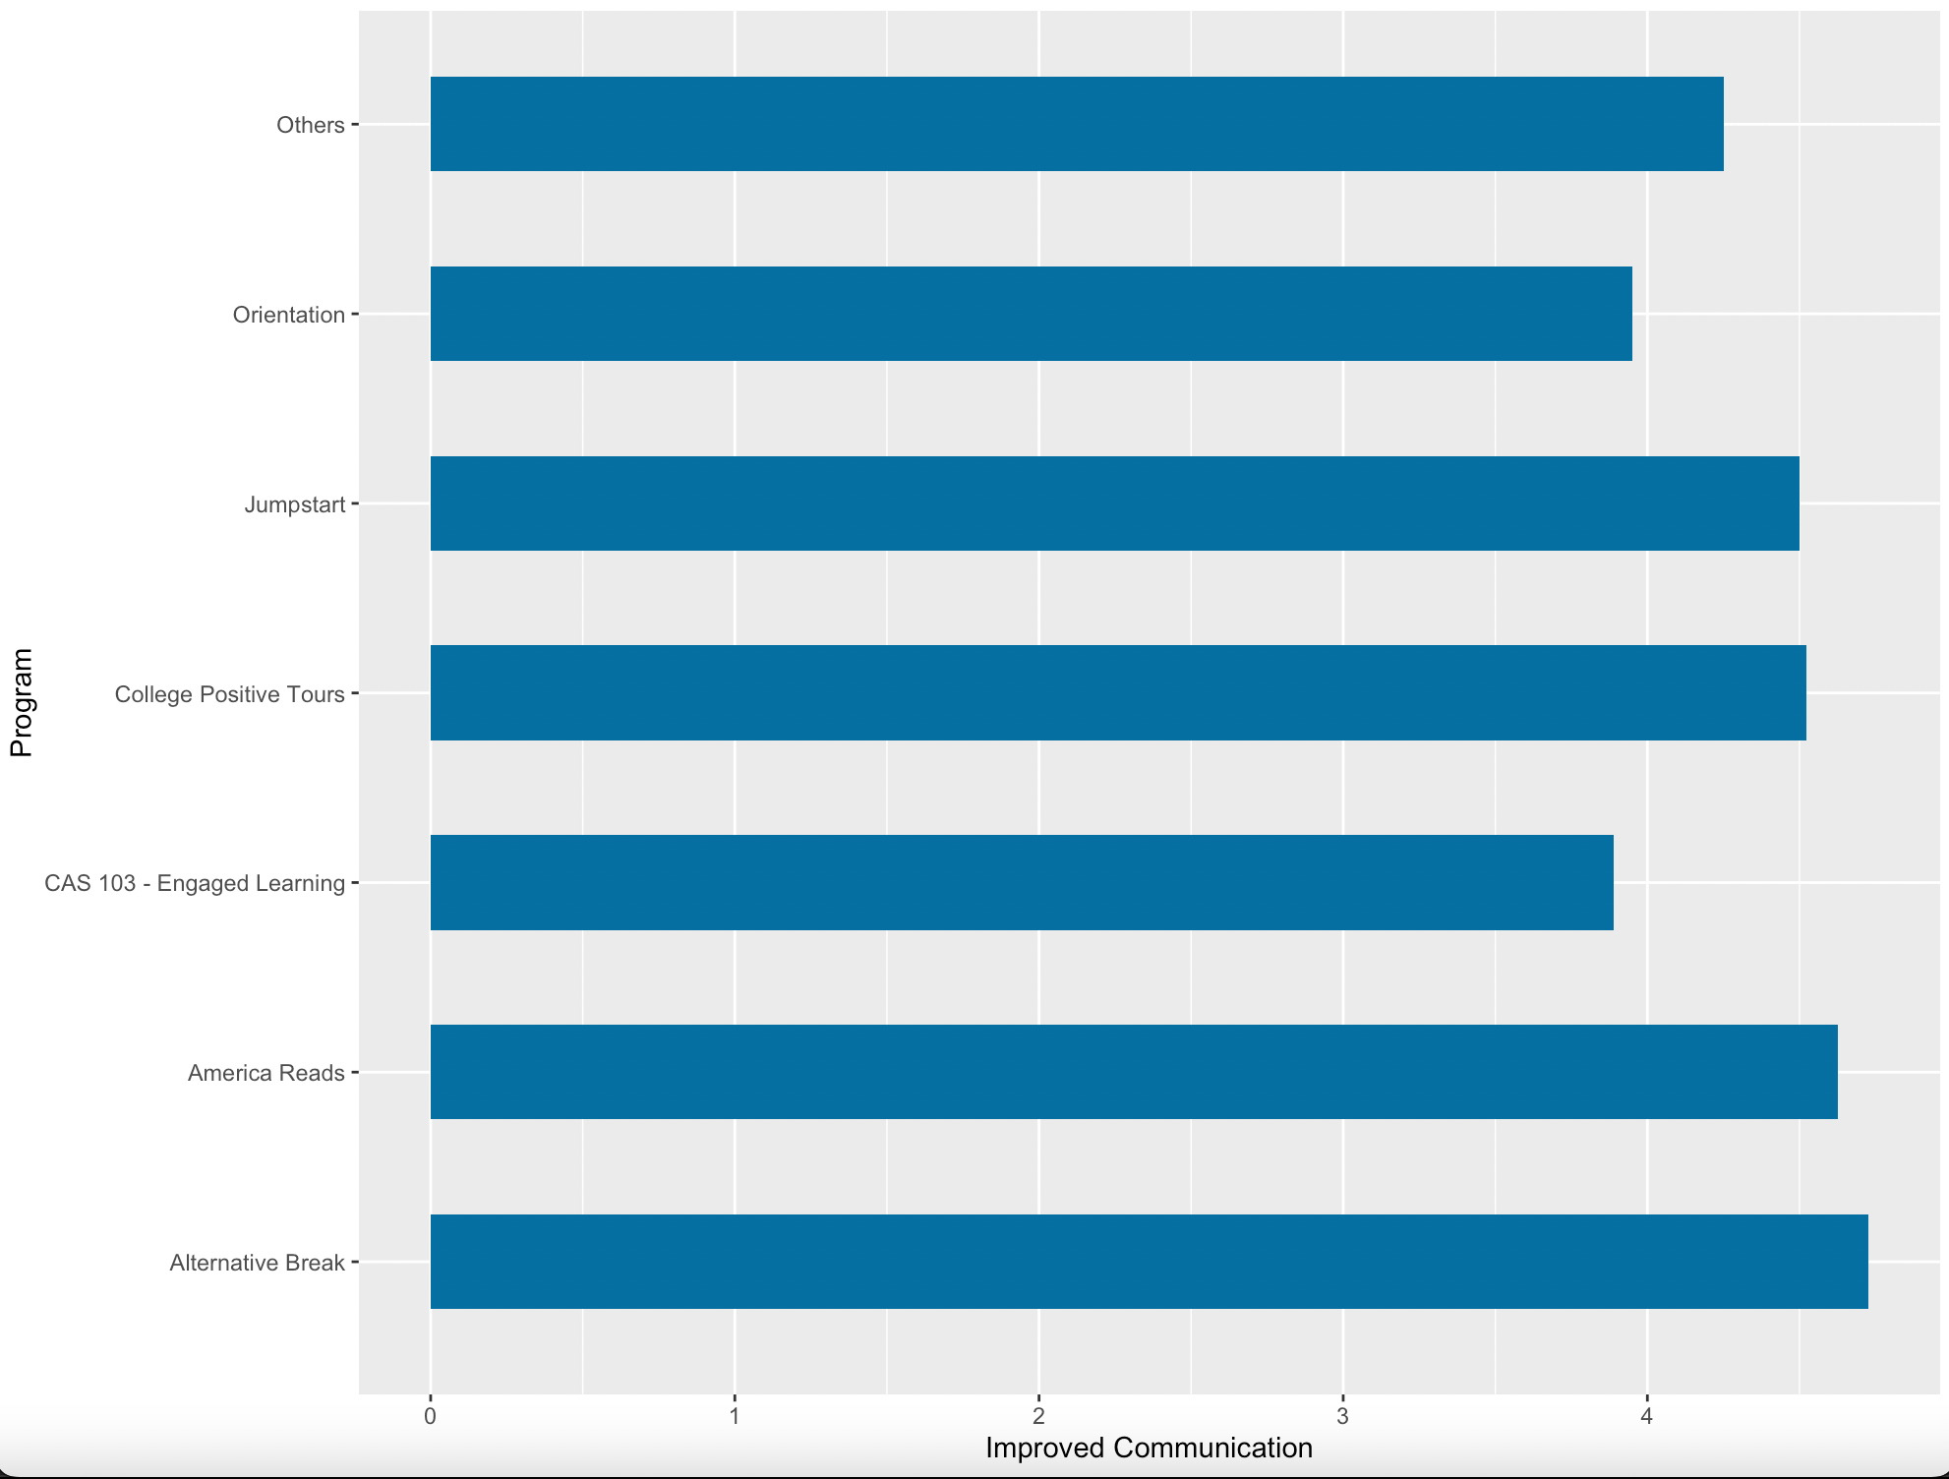
My communication skills have improved
39 (48%) out of 82 students somewhat agree that their communication skills had improved because of their civic engagement experience.
34 (41%) strongly agree that their communication skills have improved.
Among programs, participants of America Reads and Alternative Break agreed with the statement the most.

Slide 5
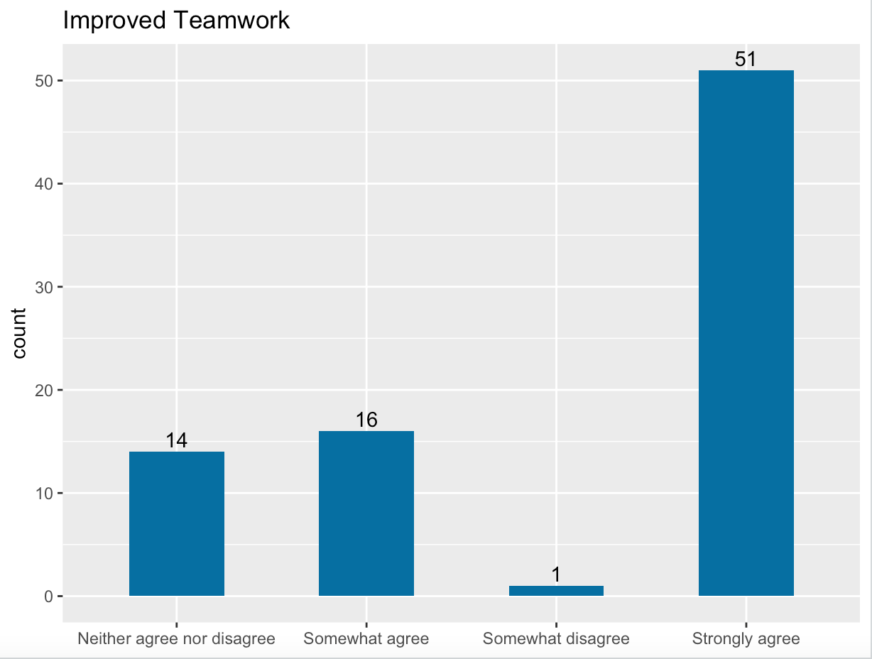
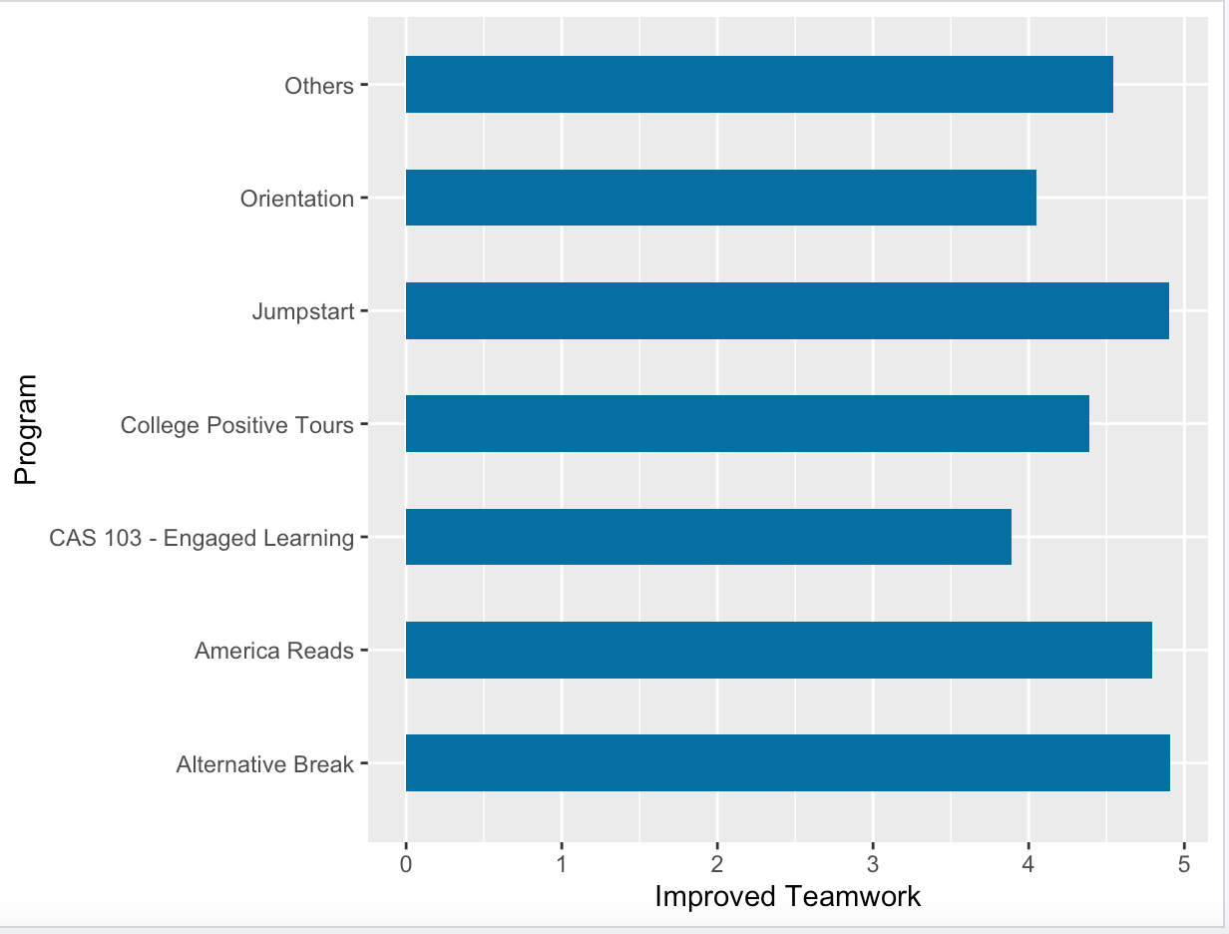
My ability to work as part of team has improved
51(62%) out of 82 students strongly agree that their ability to work as a part of the team has improved.
Amongst programs, participants of America Reads and Alternative Break agreed most strongly with the statement.

Slide 6
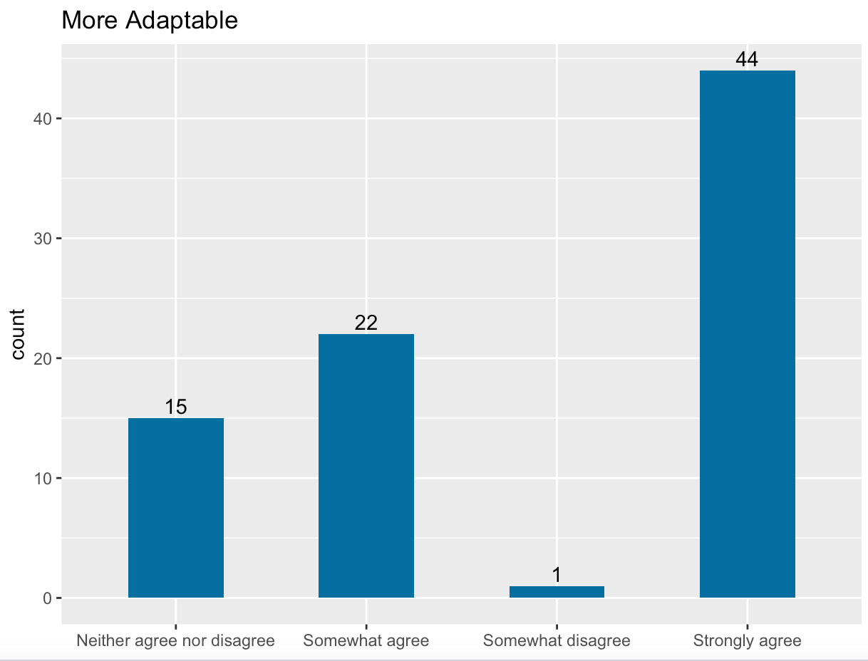
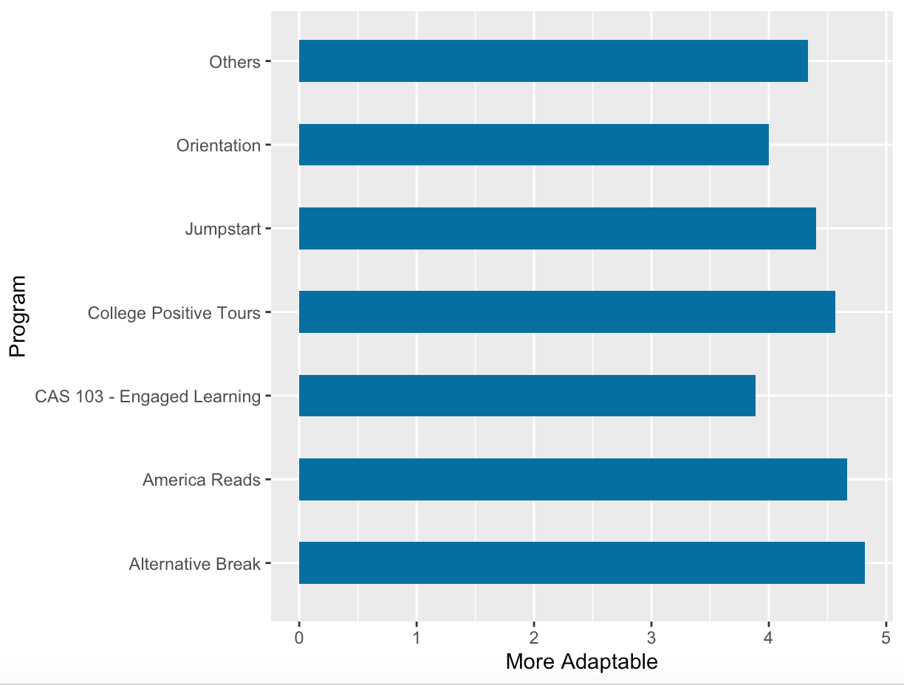
I have become more adaptable/flexible
44 (54%) out of 82 students strongly agree that they had become more adaptable/flexible because of their civic engagement experience.
22 (27%) somewhat agree that their communication skills have improved.
Among programs, participants of America Reads and Alternative Break agreed with the statement the most.

Slide 7
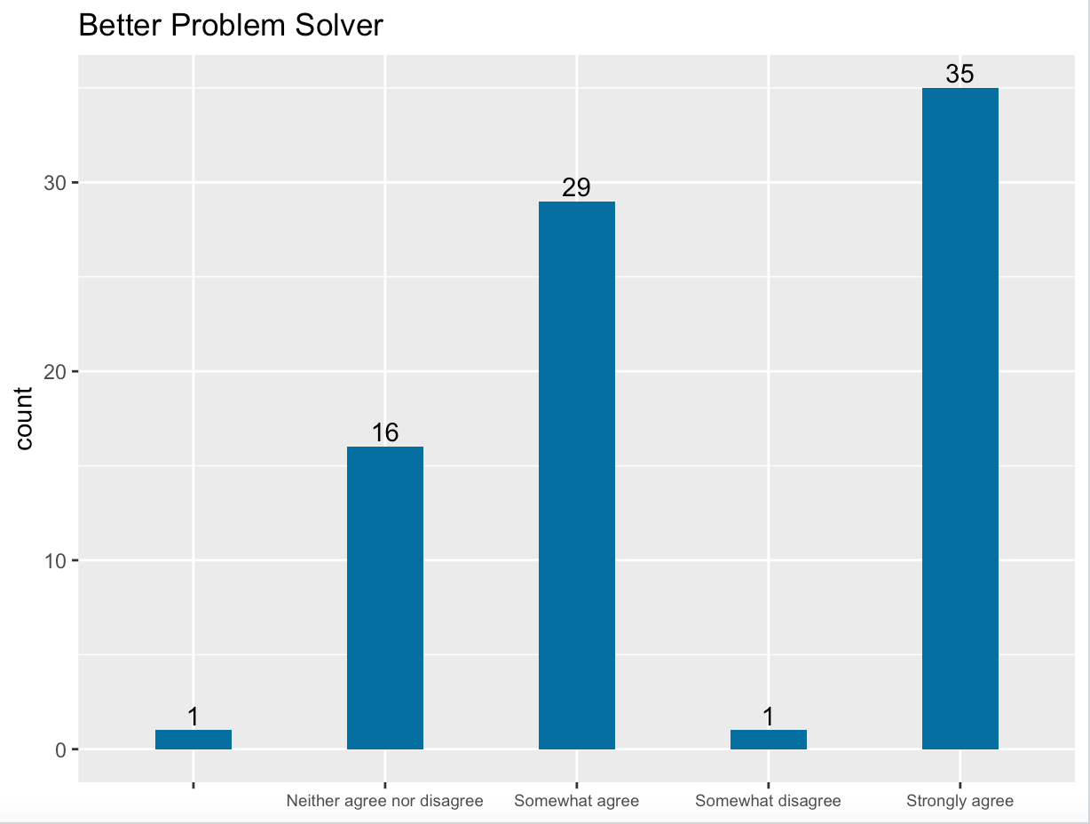
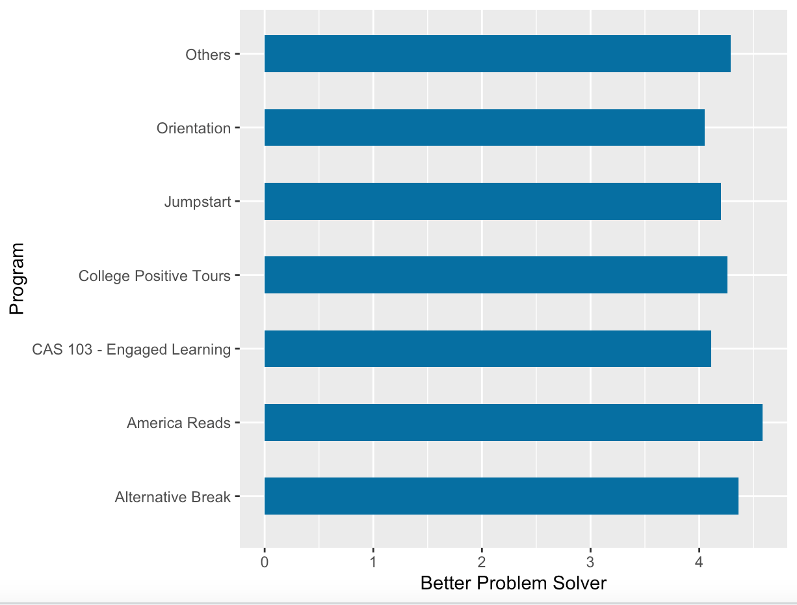
I have become a better problem solver
35 (43%) out of 82 students strongly agree that they had become a better problem solver because of their civic engagement experience .
29 (36%) somewhat agree that their communication skills have improved.
Among programs, participants of America Reads and Alternative Break agreed with the statement the most.

Slide 8
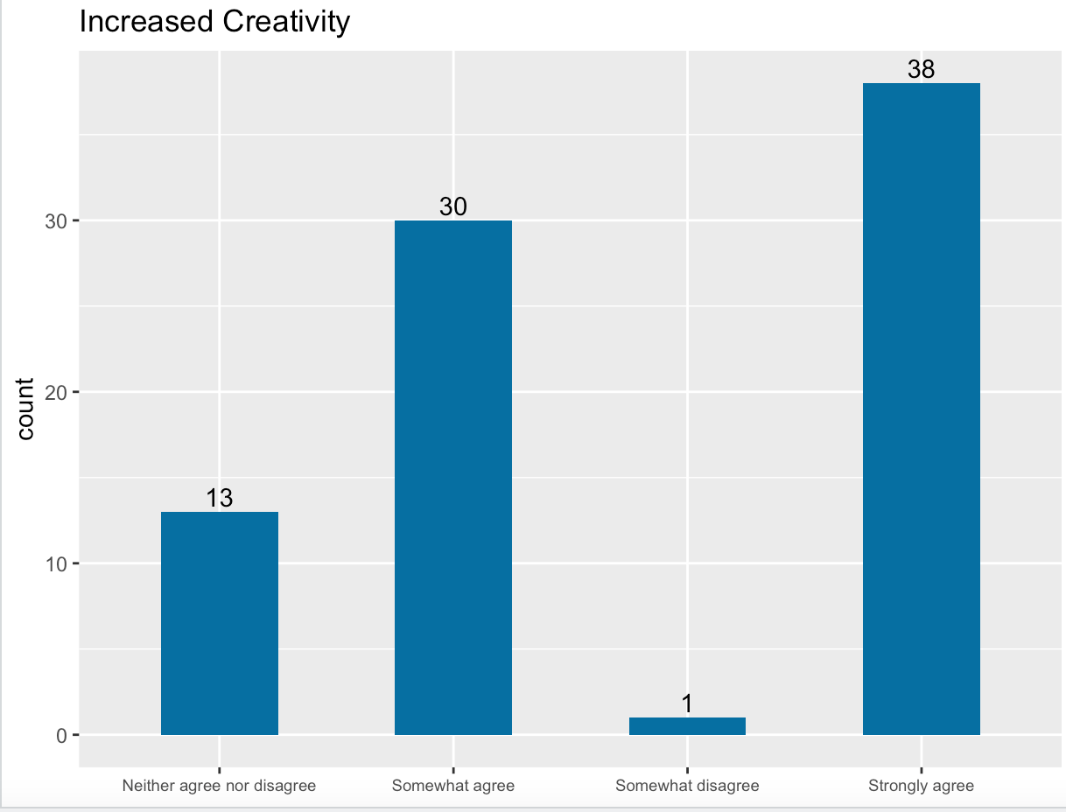
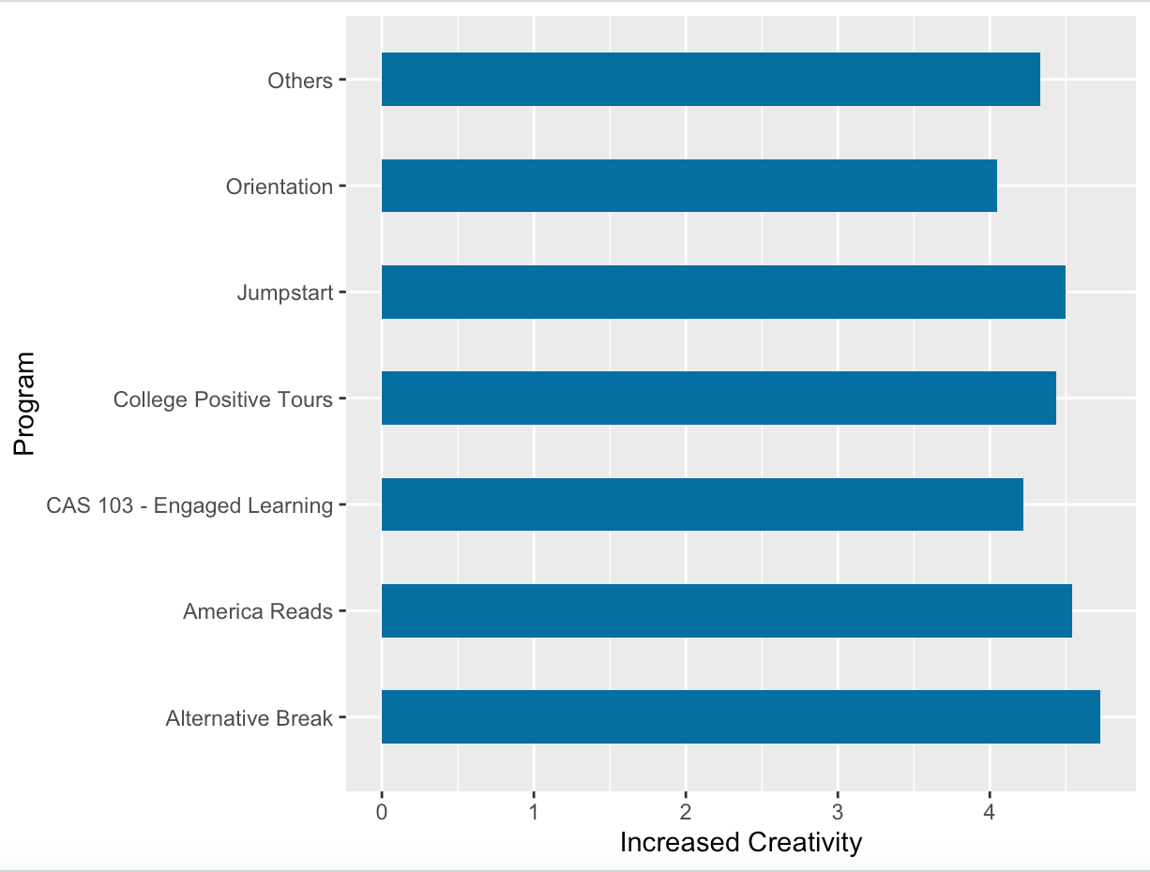
My ability to think or act creatively has increased
38 (46%) out of 82 students strongly agree that their ability to think or act creatively had increased because of their civic engagement experience .
30 (37%) somewhat agree that their communication skills have improved.
Among programs, participants of America Reads and Alternative Break agreed with the statement the most.

Slide 9

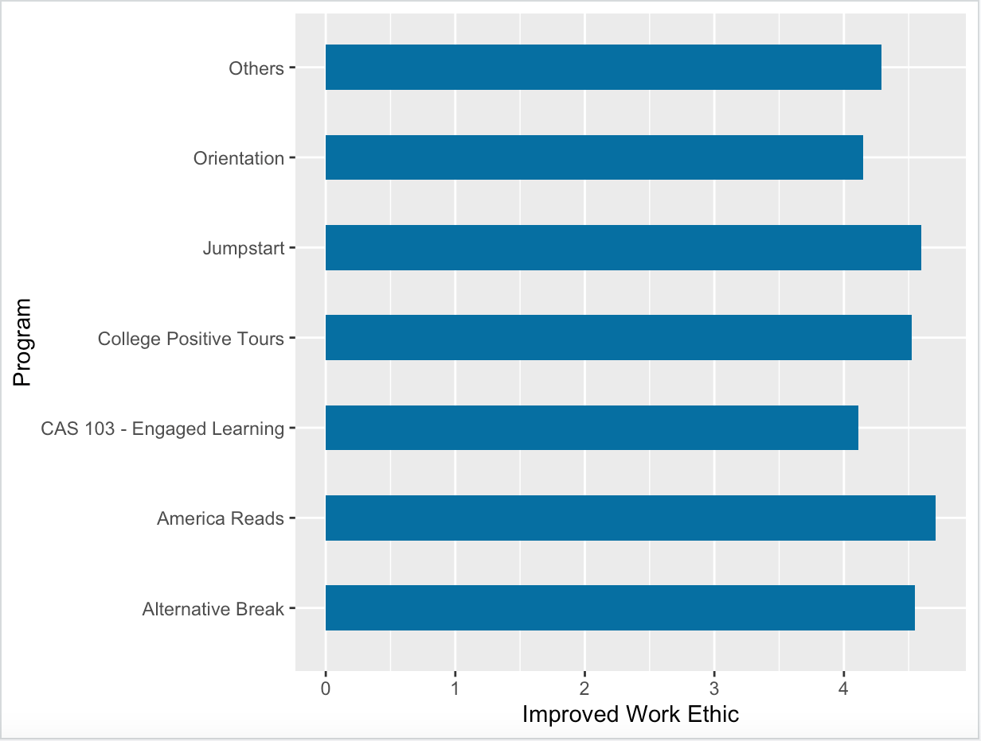
My work Ethic Has Improved
44 (54%) out of 82 students strongly agree that their work ethic had improved because of their civic engagement experience.
26 (32%) somewhat agree that their communication skills have improved.
Among programs, participants of America Reads and Jumpstart agreed with the statement the most.

Slide 10
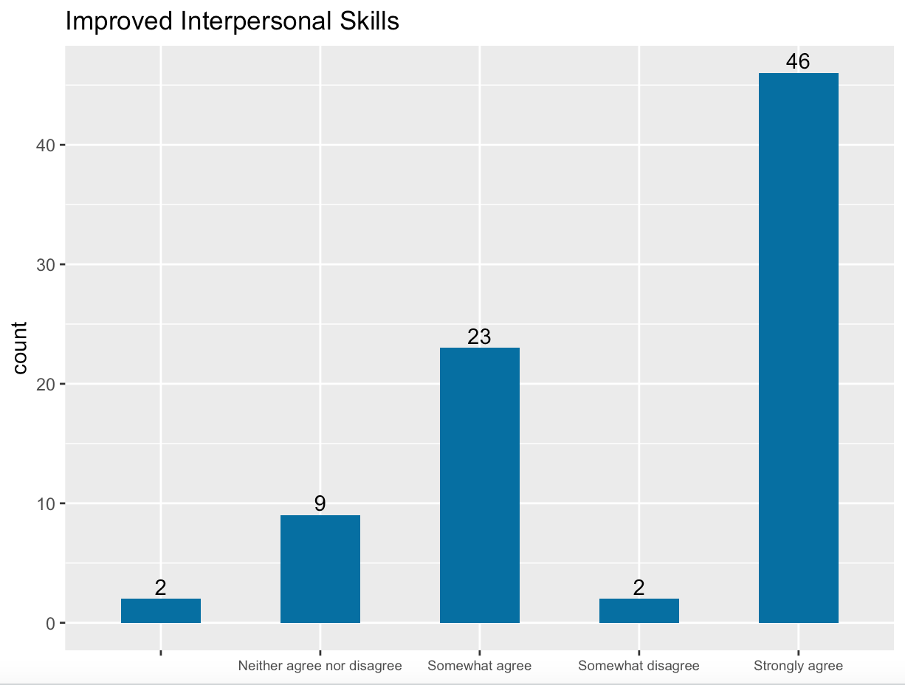
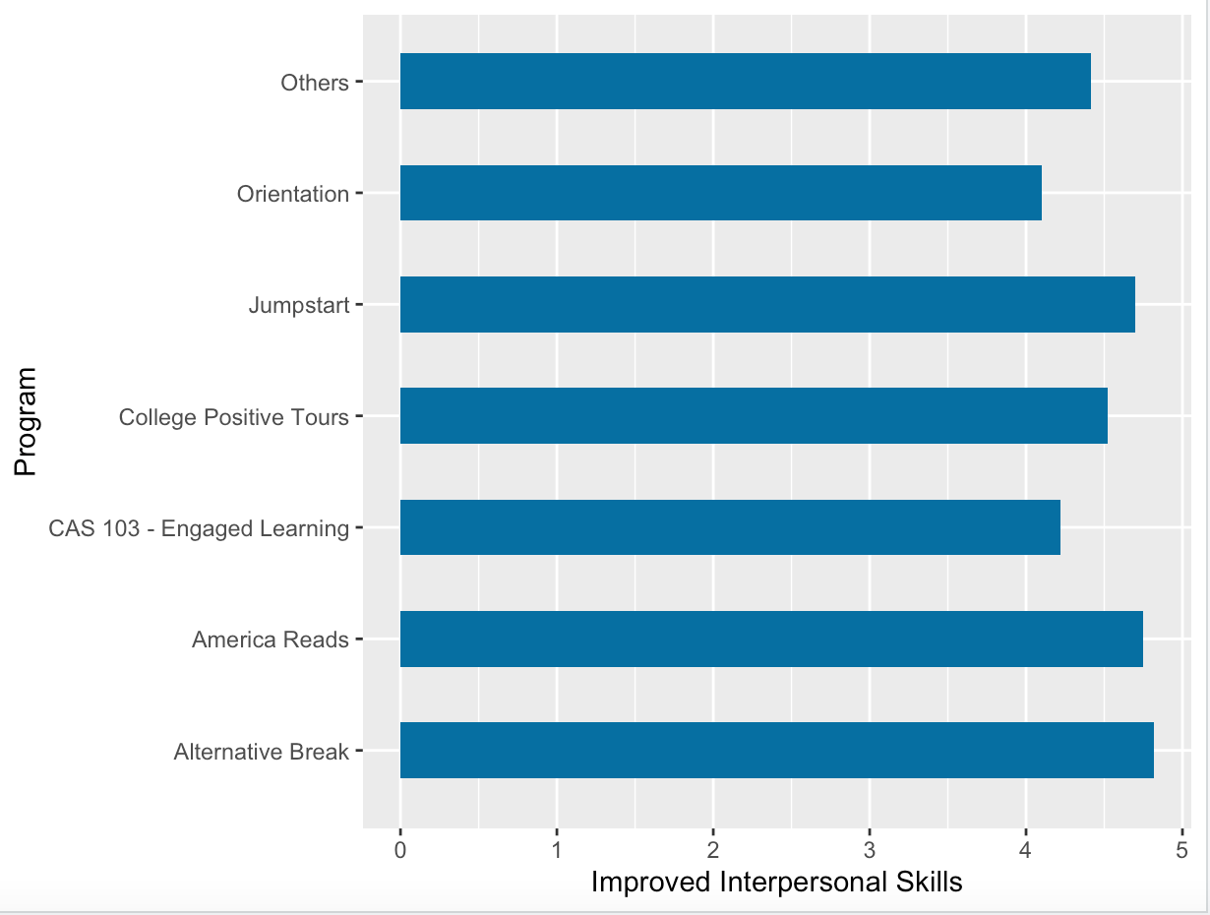
My interpersonal Skills have improved
46 (57%) out of 82 students strongly agree that their communication skills had improved because of their civic engagement experience .
Among programs, participants of America Reads and Alternative Break agreed with the statement the most.

Slide 11
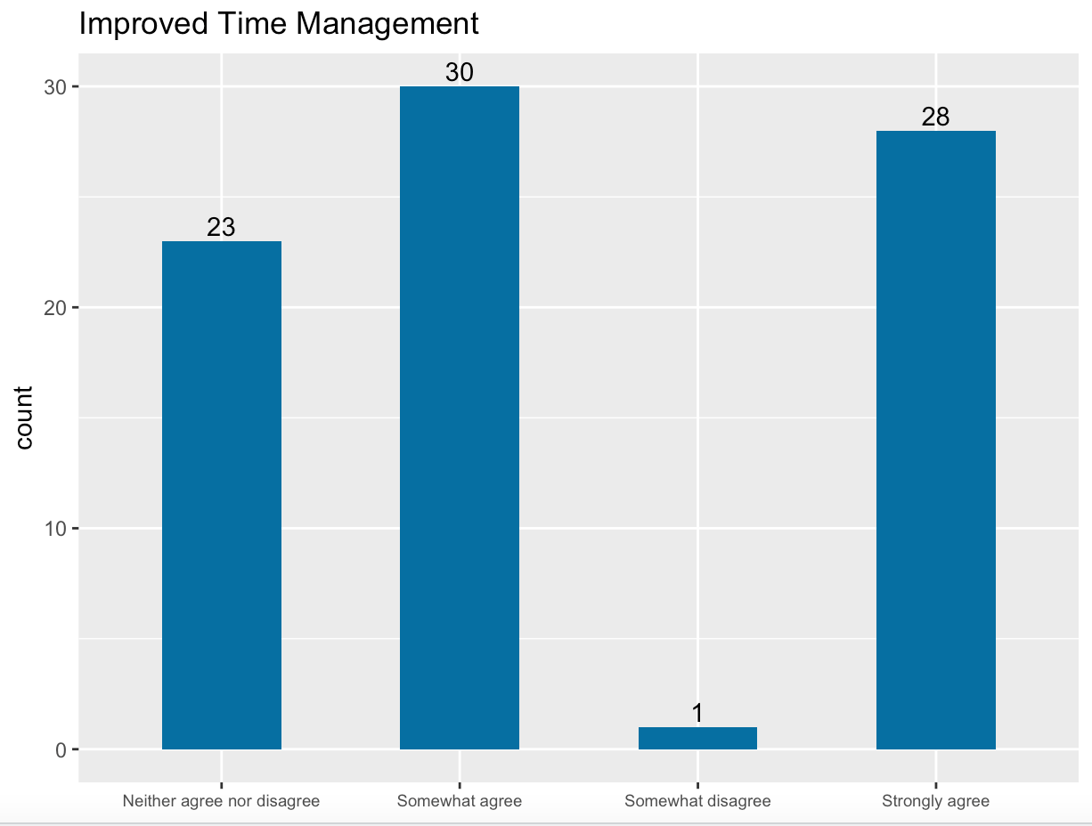
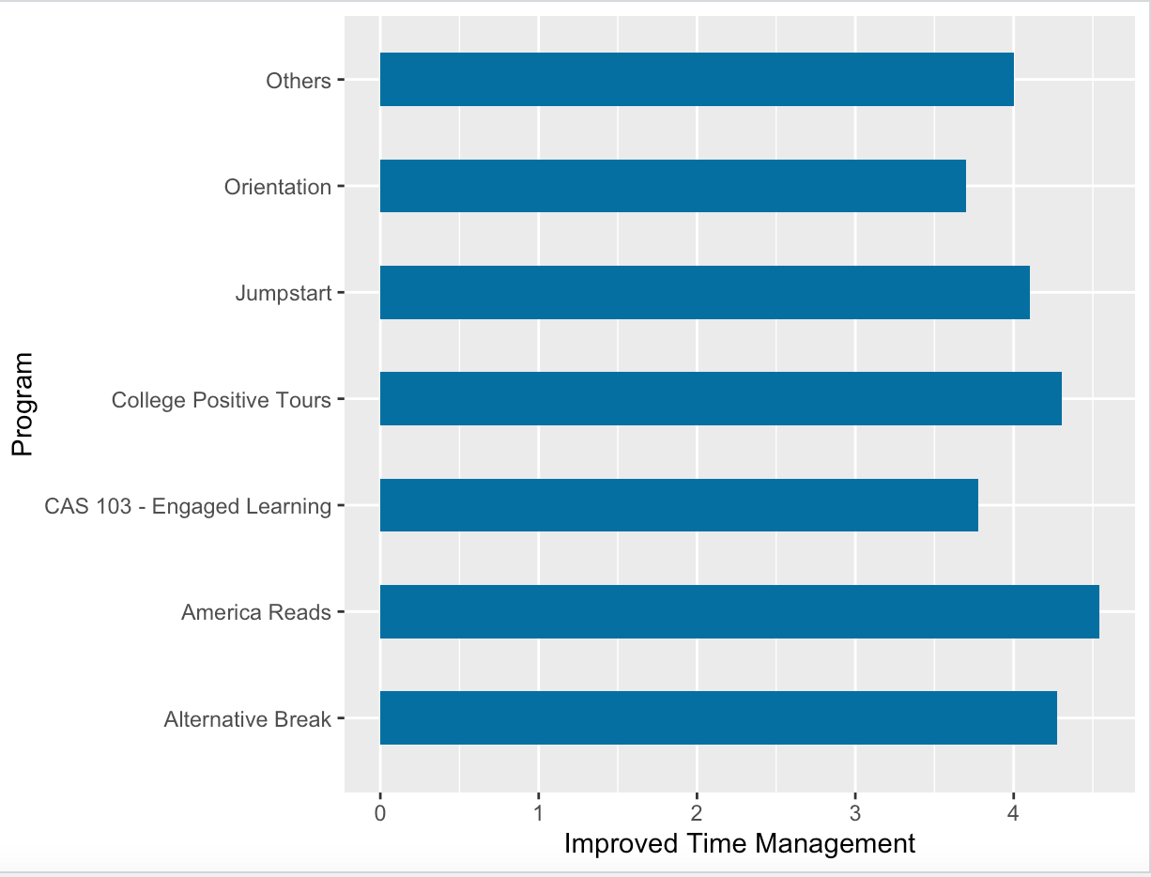
My time management skills have improved
30 (37%) out of 82 students somewhat agree that their time management skills had improved because of their civic engagement experience .
28 (34%) strongly agree that their communication skills have improved.
Among programs, participants of America Reads and College Positive Tours agreed with the statement the most.

Slide 12
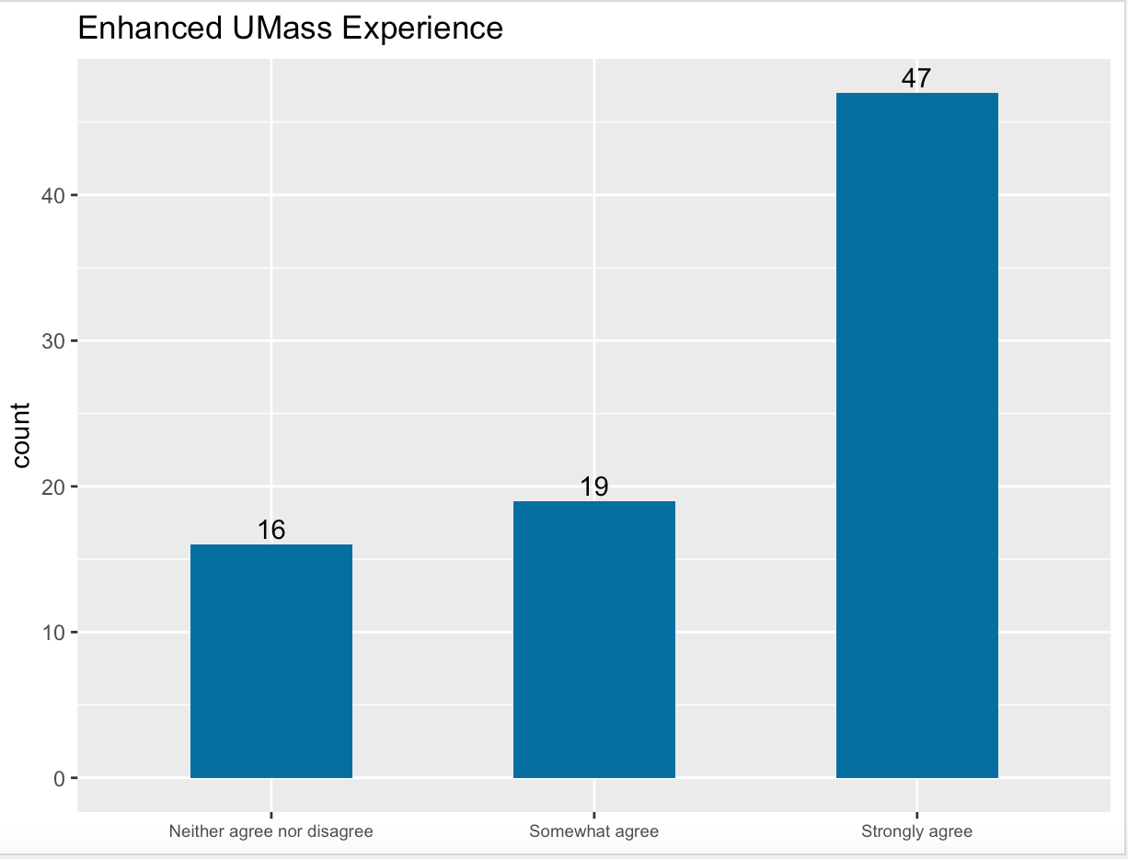
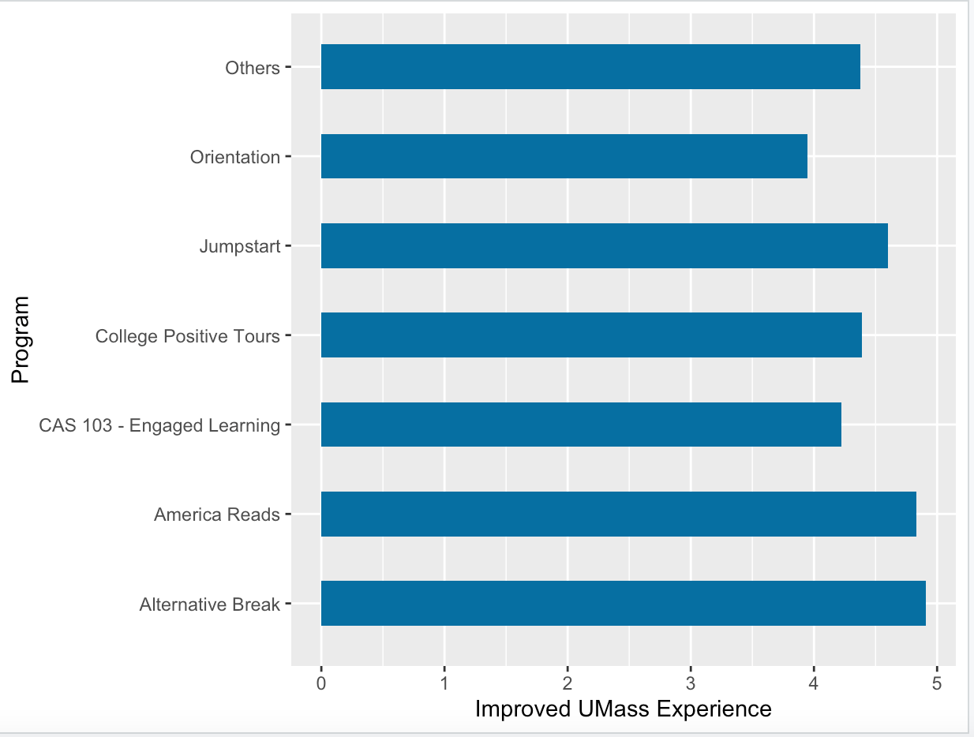
MY experience at umass Dartmouth has been enhanced
47 (57%) out of 82 students strongly agree that their experience at UMass Dartmouth had been enhanced because of their civic engagement experience.
16 (23%) students neither agree nor disagree that their communication skills have improved.
Among programs, participants of America Reads and Jumpstart agreed with the statement the most.

Slide 13
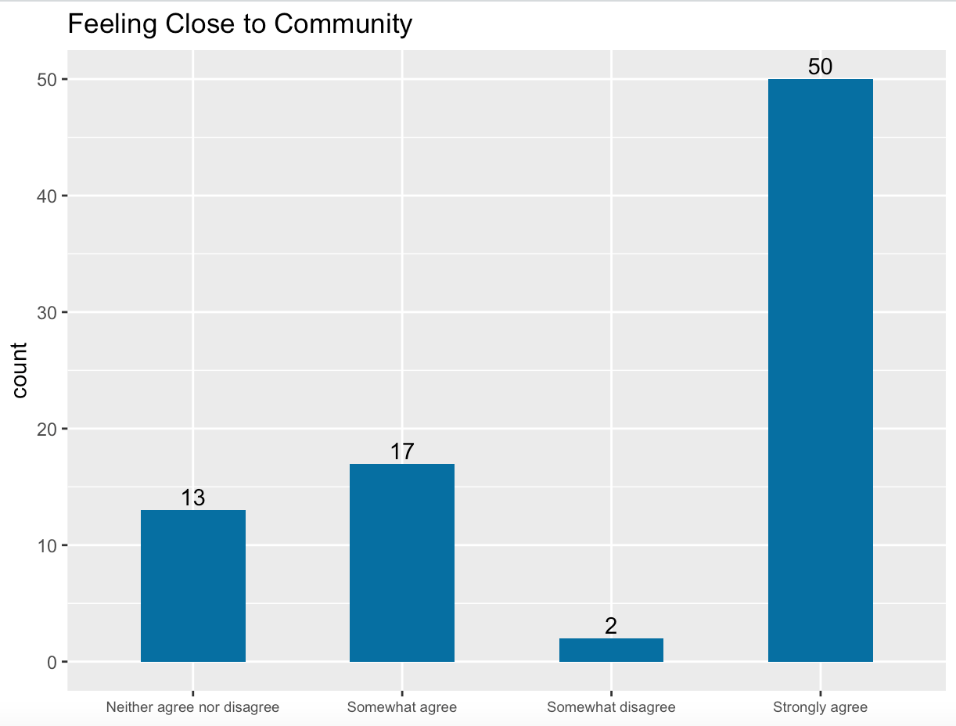
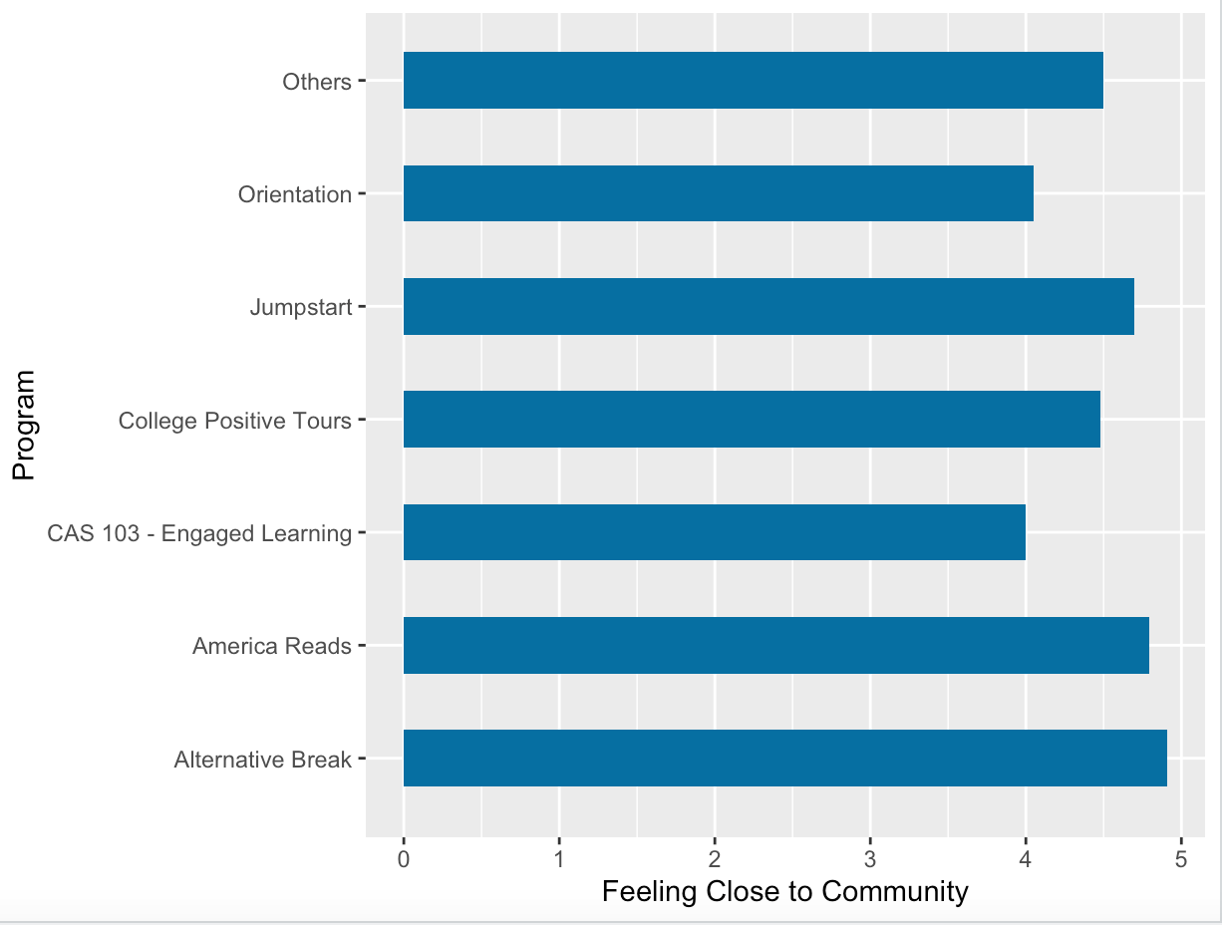
I feel a closer connection to the community
50 out of 82 students strongly agree that they felt a closer connection to the community because of their civic engagement experience (almost 61% of the respondents)
Among programs, participants of America Reads and Jumpstart agreed with the statement the most.

Slide 14
Some insights
From the charts about responses by programs, participants of America Reads, Jumpstart and Alternative Break looked back most favorably on their civic engagement experience.
They gained the most out of their experience.
Participant of longer programs felt that their civic engagement experience had a more positive impact on them than participants of one-off or shorter programs.

